Slide 1
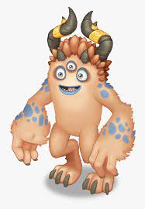
FIGHT
THE
MONSTER

Slide 2
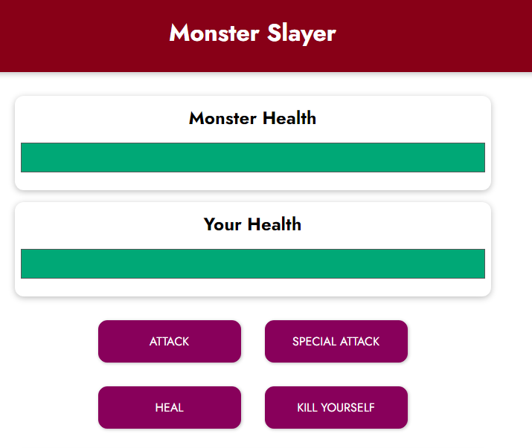
monster life
Between 0 t 100
Your life
Between 0 t 100
Attack the monster
(random value between 5 and 12)
Special Attack : only available every 3 game turns !
(random value between 8 and 25)
Get more life
(random value between 8 and 15)
Kill yourself (the game is over are you lost)

Slide 3
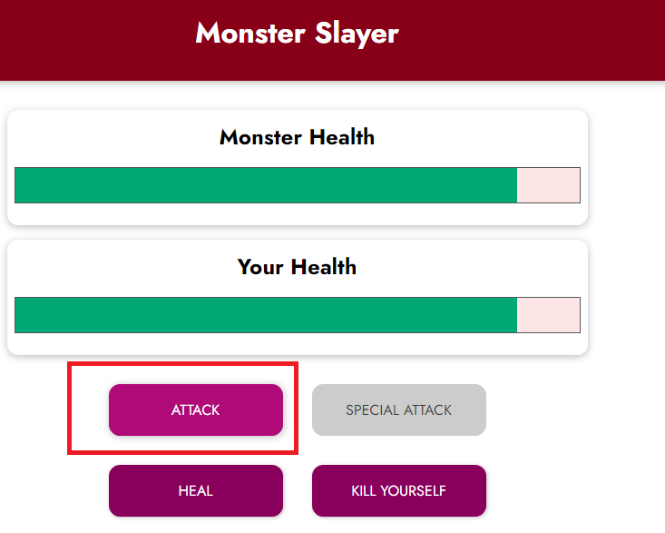
When you attack the monster,
The monster LOOSE some life
But then you monster will ATTACK you BACK !
(random value between 5 and 12)
The special attack is available
Only every 3 game turns

Slide 4
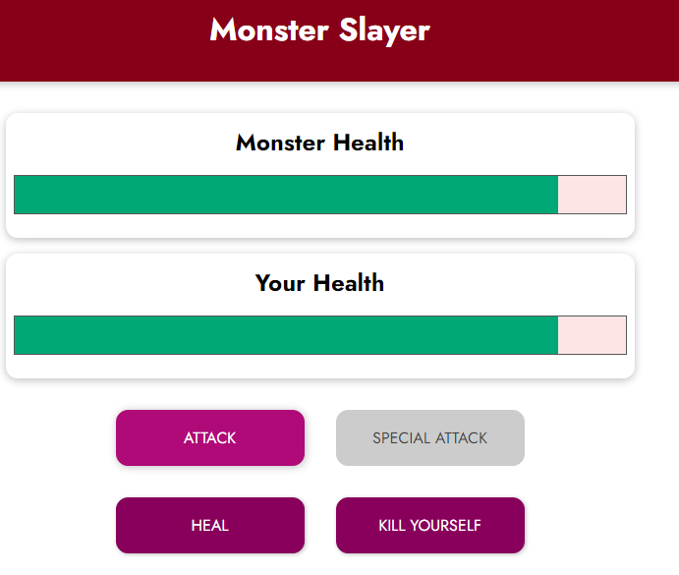
When you HEAL ,
You will gain some life
But then you monster will ATTACK you BACK !
(random value between 5 and 12)

Slide 5
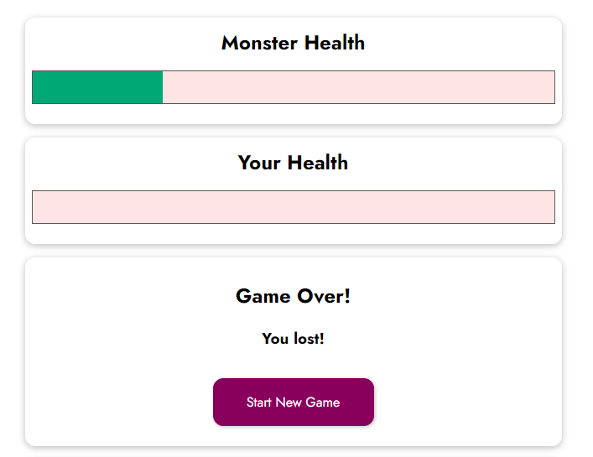
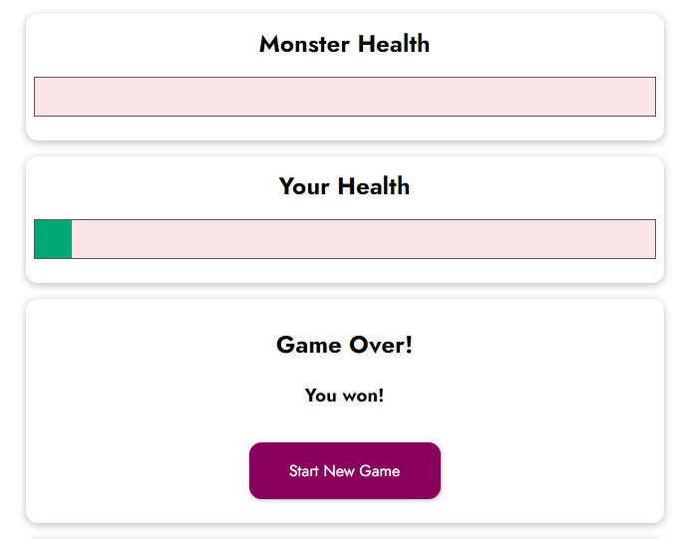
MESSAGE WHEN YOU LOST
MESSAGE WHEN YOU WON

Slide 6
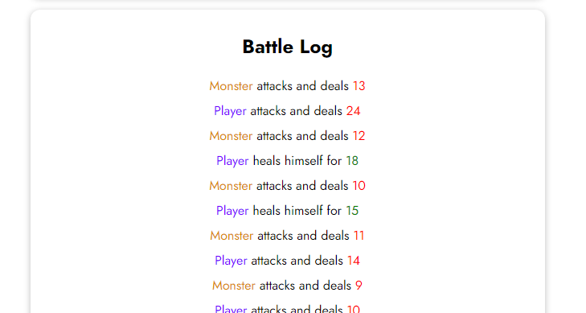
THE BATTLE LOG shall display all action results
(Player and monster attacks)

